Slide 1
First-Semester Writing Portfolio at Seton Hall University

Slide 2
Getting Started: Log into PirateNet
Go to http://www.shu.edu
Click on My Account Sign In
Enter your Username and Password
Click Sign In
Click Here

Slide 3
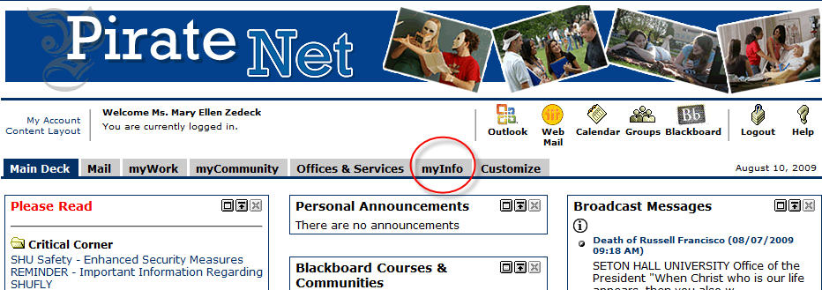
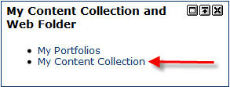
You should now be logged into PirateNet
Click on myInfo
Locate My Content Collection and Web Folder
Click My Content Collection
Click Here

Slide 4
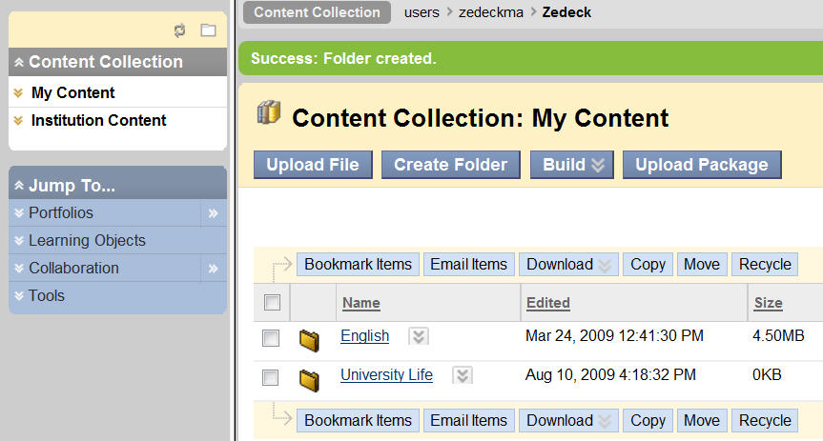
This should launch another browser window, opening the Content Collection
You are now in the Content System of Blackboard. “My Content” is similar to the hard drive on your computer. You can create folders for organization and store items such as PowerPoint files, Word files, and images.
When creating an ePortfolio, you can create links to the items that you saved in “My Content.”

Slide 5
Click here to create your folder
Organization of documents, whether on your computer in “My Document” or in the “Content System,” is very important. You should consider creating folders to store and organize your documents. This is especially important when creating your electronic portfolios, and you will see why later when you create your first portfolio.
For this particular portfolio you will need to create a folder titled “First-Year Writing Portfolio.”

Slide 6
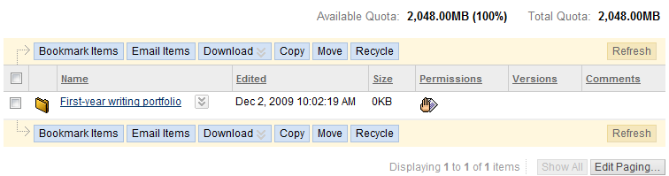
Name your folder then click “Submit.”
Click on your folder to add your files

Slide 7
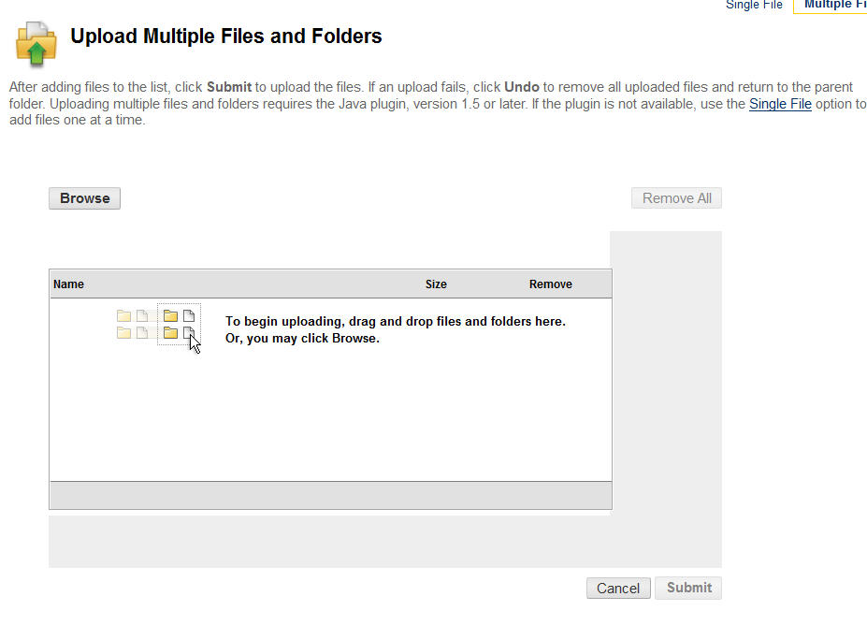
Click on “Upload Files” to add a file or files
Click “Browse” to locate the file or files on your computer. But first, remember to delete your name and your teacher’s name throughout the document.

Slide 8
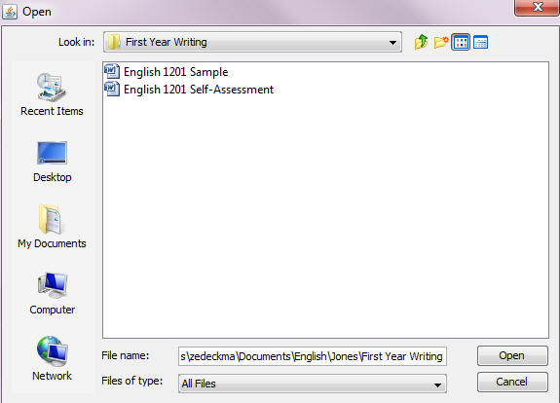
Highlight file or files that you want to add. You will ONLY be adding the English 1201 sample and self-assessment this semester.
Click “Open”

Slide 9
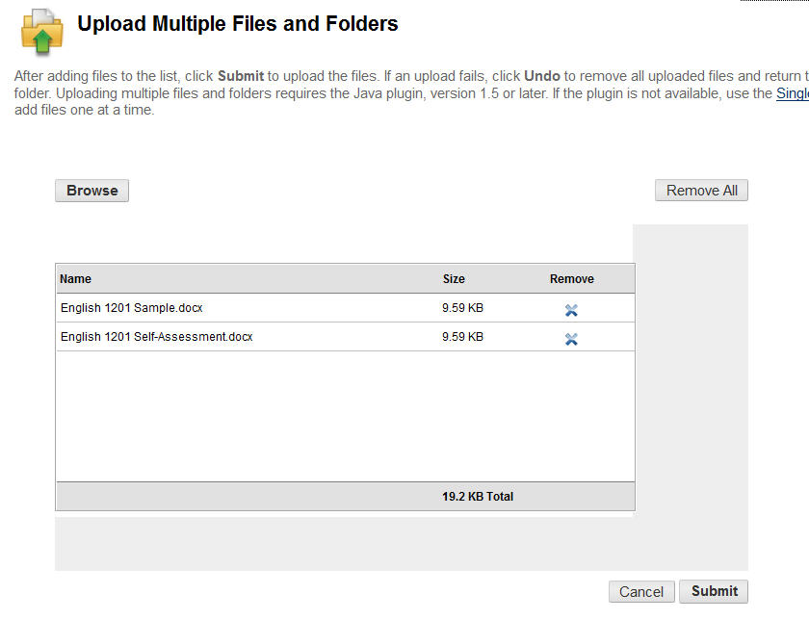
Click Submit to finish uploading the file or files

Slide 10
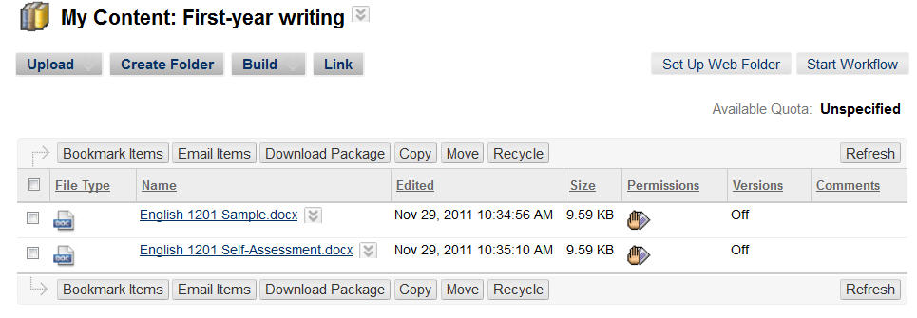
You will upload only the English 1201 sample and 1201
self-assessment into your “My Content” space.

